Slide 1

Convolutional Neural Networks
Computer vision
deeplearning.ai

Slide 2
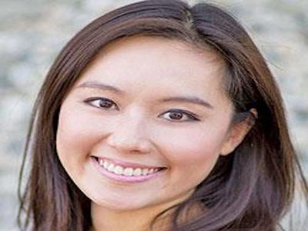
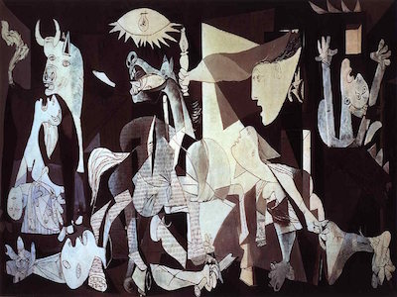
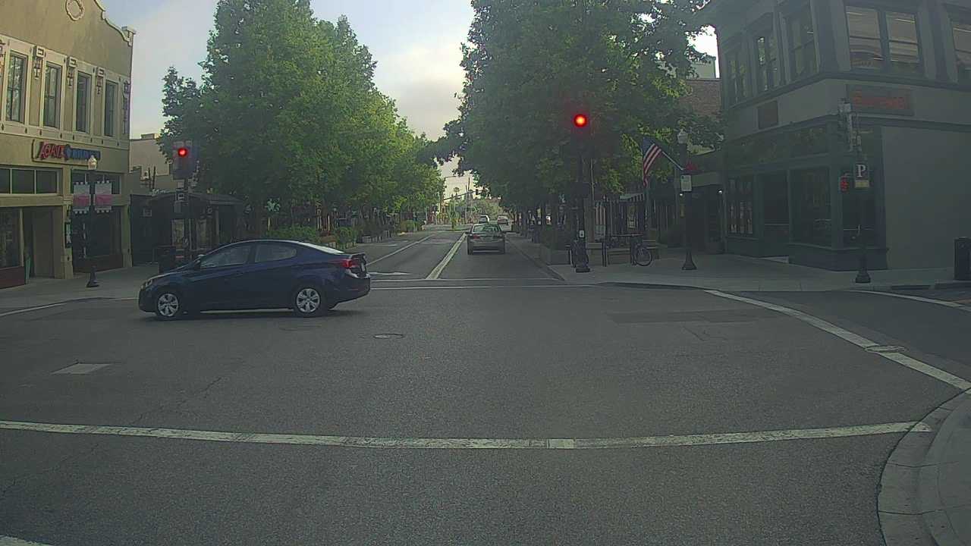
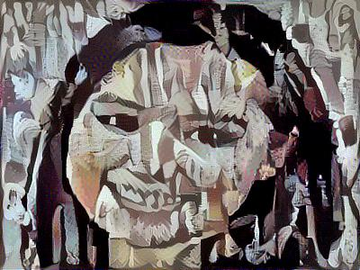
Computer Vision Problems
Image Classification
Neural Style Transfer
Cat? (0/1)
64x64
Object detection

Slide 3

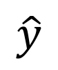
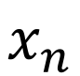
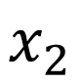
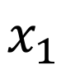

Deep Learning on large images
Cat? (0/1)
64x64
$$x_{1}$$
$$x_{2}$$
$$⋮$$
$$⋮$$
$$⋮$$
$$\hat{y}$$
$$x_{n}$$

